Slide 1
Session2 -Data preprocessing
Dr. Vijayalakshmi Anand
Professor ,Computer science department, BITS- Pilani

Slide 2

The slides presented here are obtained from the authors of the books and from various other contributors. I hereby acknowledge all the contributors for their material and inputs.
I have added and modified a few slides to suit the requirements of the course.

Slide 3
Session#2 – Data Pre processing
Data Preprocessing Concept
Data Quality
Major task in Data preprocessing
Data Cleaning
Data Integration
Data transformation
Data reduction

Slide 4
Preprocessing Objectives
To improve data quality
To modify data to better fit specific data mining technique

Slide 5
Why Data Preprocessing
Data in the Real World Is Dirty: Lots of potentially incorrect data, e.g., instrument faulty, human or computer error, transmission error
incomplete: lacking attribute values, lacking certain attributes of interest, or containing only aggregate data
e.g., Occupation = “ ” (missing data)
noisy: containing noise, errors, or outliers
e.g., Salary = “−10” (an error)
inconsistent: containing discrepancies in codes or names, e.g.,
Age = “42”, Birthday = “03/07/2010”
Was rating “1, 2, 3”, now rating “A, B, C”
discrepancy between duplicate records
Intentional (e.g., disguised missing data)
Jan. 1 as everyone’s birthday?

Slide 6
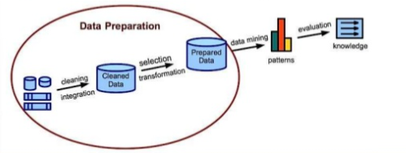
What is Data Preprocessing
Technique by which we can convert a raw data into an understandable format
6

Slide 7
Let’s understand the task of data pre-processing

Slide 8
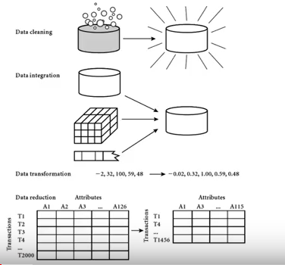

Slide 9

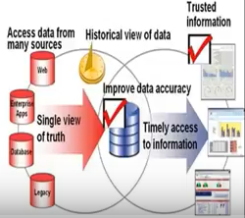
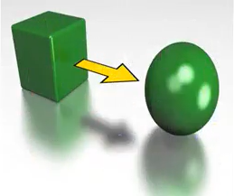
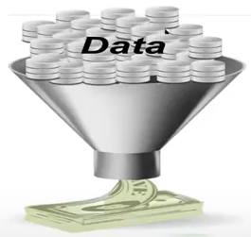
Major Tasks in Data Preprocessing
Data cleaning
Fill in missing values
smooth noisy data
identify or remove outliers
resolve inconsistencies
Data integration
Integration of multiple databases,
data cubes, or files
Data transformation and data discretization
Normalization
Concept hierarchy generation
Data reduction
Dimensionality reduction
Numerosity reduction
Data compression

Slide 10
Data Quality: Multidimensional View
Measures for data quality: A multidimensional view
Accuracy: correct or wrong, accurate or not
Completeness: not recorded, unavailable, …
Consistency: some modified but some not, …
Timeliness: timely update?
Believability: how trustable the data are correct?
Interpretability: how easily the data can be understood?

Slide 11
To achieve Data Quality
What kinds of data quality problems?
How can we detect problems with the data?
What can we do about these problems?
Examples of data quality problems:
Noise and outliers
missing values
duplicate data

Slide 12
Incomplete (Missing) Data
Data is not always available
E.g., many tuples have no recorded value for several attributes, such as customer income in sales data
Missing data may be due to
equipment malfunction
inconsistent with other recorded data and thus deleted
data not entered due to misunderstanding
certain data may not be considered important at the time of entry
not register history or changes of the data
Missing data may need to be inferred

Slide 13
How to Handle Missing Data?
Ignore the tuple: usually done when class label is missing (when doing classification)—not effective when the % of missing values per attribute varies considerably
Fill in the missing value manually: tedious + infeasible?
Fill in it automatically with
a global constant : e.g., “unknown”, a new class?!
the attribute mean for all samples belonging to the same class: smarter
the tuple mean
The most probable value: inference-based such as Bayesian formula or decision tree

Slide 14

Noisy Data
Noise: random error or variance in a measured variable
Problems?
Reasons
Incorrect attribute values may be due to
faulty data collection instruments
data entry problems
data transmission problems
technology limitation
inconsistency in naming convention

Slide 15
How to Handle Noisy Data?
Binning (also used for discretization)
first sort data and partition into (equal-frequency) bins
then one can smooth by bin means, smooth by bin median, smooth by bin boundaries, etc.
Binning methods smooth a sorted data value by consulting its "neighbourhood," that is, the values around it, i.e. they perform local smoothing.
Regression
smooth by fitting the data into regression functions
Clustering
detect and remove outliers
Combined computer and human inspection
detect suspicious values and check by human (e.g., deal with possible outliers)

Slide 16
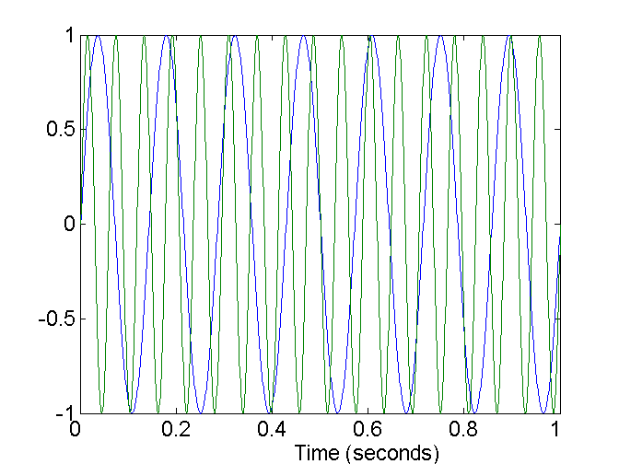
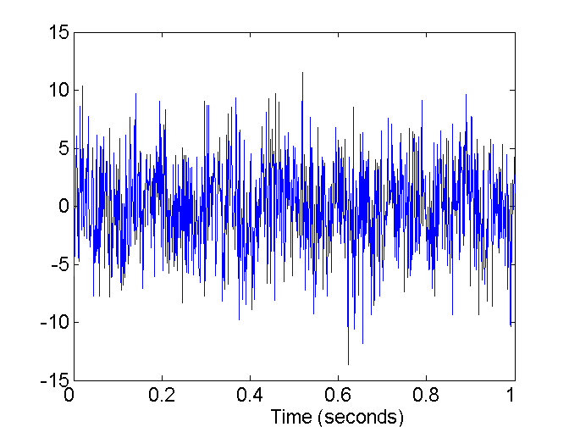
Noise Example
Noise refers to modification of original values
Examples: distortion of a person’s voice when talking on a poor phone and “snow” on television screen
Two Sine Waves
Two Sine Waves + Noise

Slide 17
Outliers
Outliers are data objects with characteristics that are considerably different than most of the other data objects in the data set
Why do we identify the outlier?

Slide 18
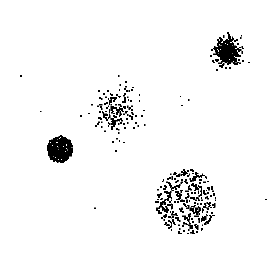
Outlier detection by cluster analysis

Slide 19
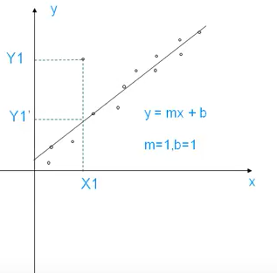
Contd..
Outlier detection by regression
Linear regression: Best line to fit two variables
Multiple regression: More than two variable fit to a multidimensional surface

Slide 20
Duplicate Data
Data set may include data objects that are duplicates, or almost duplicates of one another
Major issue when merging data from heterogeous sources
Examples:
Same person with multiple email addresses
Reasons?
Data cleaning
Process of dealing with duplicate data issues

Slide 21
Handling data inconsistency
Manual correction using external references
Semi-automatic using various tools
To detect violation of unknown functional dependencies and data constraints
To correct redundant data

Slide 22
Any problems with the Data?
Name | Age | DateOfFirstBuy | Profession | DateOfBirth
Bill Gates | 34 | 15-Jan-2015 | MGR | Feb 24, 1981
John | 33 | 27-Jan-2015 |  | Mar 27, 1982
William Gates | 34 | 15-Jan-2015 | MGR | Feb 24, 1981
Kennedy | 32 | 30-Jan-2015 | DOC | Nov 25,1982

Slide 23
Any problems with the Data?
Name | Age | DateOfFirstBuy | Profession | DateOfBirth
Bill Gates | 34 | 15-Jan-2015 | engr | Feb 24, 1981
John | 33 | 27-Jan-2015 |  | Mar 27, 1982
William Gates | 34 | 15-Jan-2015 | ENGR | Feb 24, 1981
Kennedy | 32 | 30-Jan-2015 | DOC | Nov 25,1982
Missing values in Profession column
Format of DateOfFirstBuy and DateOfBirth are different, needs standardization
Row 1 and Row 3 are potentially duplicate data.
Both Age and DateOfBirth are stored. Age is derived attribute.
Inconsistent format for name, missing first or last names
Entity identification issues

Slide 24
Data Integration

Slide 25

Data integration
Task of data integration
Data integration: combines data from multiple sources into a coherent store
Challenges due to semantic heterogeneity and structure of data
entity identification problem due to schema integration of metadata from different sources
Are any attributes correlated? (Redundancy)
Tuple duplication
Detecting and resolving data value conflicts

Slide 26
Entity Identification
“How can equivalent real-world entities from multiple data sources be matched up?”
E.g customer id in one database and cust number in another refer to the same attribute? i.e. A.customer_id = B.cust_number?
Use of metadata
To avoid errors in schema integration
To transform the data
Metadata is data about data

Slide 27
Handling Redundancy
Redundant data occur often when integration of multiple databases
Object identification: The same attribute or object may have different names in different databases
Derivable data: One attribute may be a “derived” attribute in another table, e.g., annual revenue
Careful integration of the data from multiple sources may help reduce/avoid redundancies and inconsistencies and improve mining speed and quality

Slide 28
Handling Redundancy (cont…)
Redundancies can be detected by correlation analysis.
Given two attributes, such analysis can measure how strongly one attribute implies the other, based on the available data
For nominal data, we use the χ2 (chi-square) test
For numeric attributes, we can use the correlation coefficient and covariance,
How one attribute’s values vary from those of another

Slide 29
Correlation Analysis (Nominal Data)
χ2 (chi-square) test
The larger the Χ2 value, the more likely the variables are related
The cells that contribute the most to the Χ2 value are those whose actual count is very different from the expected count
Correlation does not imply causality
# of hospitals and # of car-theft in a city are correlated
Both are causally linked to the third variable: population

Slide 30
Correlation Analysis (Nominal Data)
Presume you observe 100 people to see who deposits garbage in the can and who litters. You want to see if there is a difference based on gender?
Male deposits garbage-42
Male litters 33
Female deposits garbage18
Female litters 7

Slide 31
Steps
1.
Null Hypothesis: No relation between gender and garbage deposit
Alternate Hypothesis-Relation between gender and garbage deposit
2. Create Contigency matrix
3.Find Expected value =row total*column total/total

Slide 32
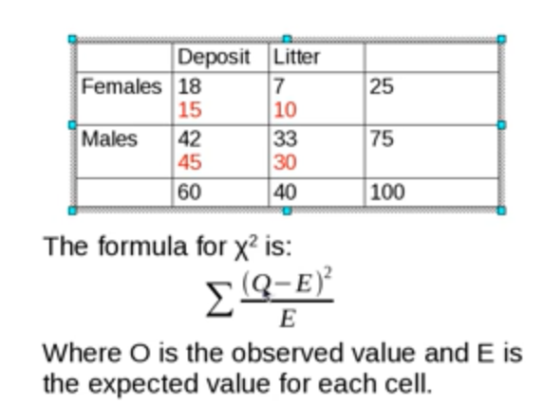
Correlation Analysis (Nominal Data)
4.Apply chi square formula
(15)
(10)
(45)
(30)

Slide 33
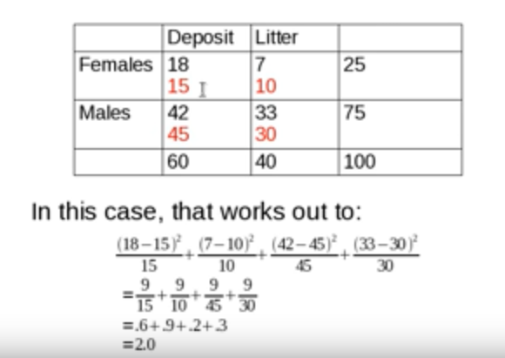

Slide 34
Correlation Analysis (Nominal Data)
5.Degree of freedom is :
(number of row – 1) * (number of column – 1)
For this example degree of freedom is?
Answer is 1 as (2-1) * (2-1)
For 1 degree of freedom
6.Significance level .05
7.Compare χ2 value with the theoretical value
If χ2 value >theoretical value then we can reject the null hypothesis
If χ2 value <theoretical value –accept the null hypothesis
Here Since the computed value is below this, conclude that the two attributes are not correlated i.e. there is no relation between gender and garbage deposit

Slide 35
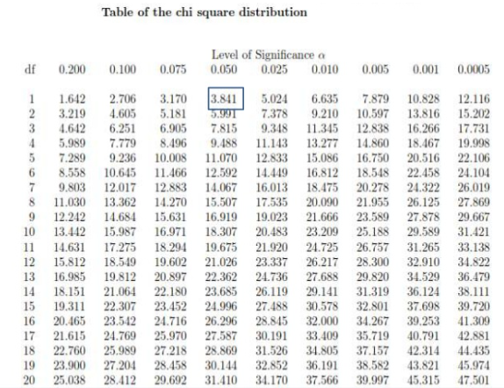
Correlation Analysis (Nominal Data)

Slide 36
Correlation Analysis (Nominal Data)
Example 2
You publish book in three different colour and see how many people take them or not is there a significant effect of colour?
 | White | Blue | Pink | Sum
Take | 32 | 38 | 20 | 90
Don’t take | 8 | 22 | 30 | 60
Total | 40 | 60 | 50 | 150
24
36
30
16
24
20

Slide 37
Correlation Analysis (Nominal Data)
Value of χ2 is 15.28
For 2 degree of freedom, the χ2 value needed to reject the hypothesis at the 0.001 significance level is 13.816
Since the computed value is above this, we can reject the hypothesis that colour of the book wont affect the sell and conclude that the two attributes are (strongly) correlated

Slide 38
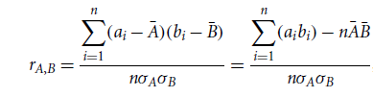
Correlation Coefficient for Numeric Data
For numeric attributes, we can evaluate the correlation between two attributes, A and B, by computing the correlation coefficient (also known as Pearson’s product moment coefficient, named after its inventer, Karl Pearson)
n=no of tuples
ai and bi are the respective values of A and B in tuple i
respective mean values of A and B,
respective standard deviations of A and B
sum of the AB cross-product
38

Slide 39
Correlation Coefficient for Numeric Data
If rA,B is greater than 0, then A and B are positively correlated, i.e. the values of A increase as the values of B increase
The higher the value, the stronger the correlation (i.e., the more each attribute implies the other)
Hence, a higher value may indicate that A (or B) may be removed as a redundancy
If the resulting value is equal to 0, then A and B are independent and there is no correlation between them
If the resulting value is less than 0, then A and B are negatively correlated, where the values of one attribute increase as the values of the other attribute decrease
39

Slide 40



Covariance of Numeric Data
Covariance is similar to correlation
Consider two numeric attributes A and B, and a set of n observations {(a1,b1),.., (an,bn)}.
The mean values of A and B, respectively, are also known as the expected values on A and B,
The covariance between A and B is defined as

Slide 41

Covariance of Numeric Data
It can also be shown as:
Positive covariance- if >0, then both A and B tend to be larger than their expected value
Negative covariance – if <0 , if A is larger than its expected value B is likely to be smaller than its expected valued
Independence =0

Slide 42
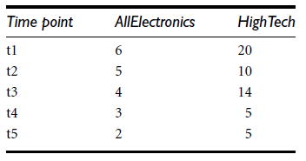



Covariance of Numeric Data
Example
The table shows the stock prices of two companies
If the stocks are affected by the same industry trends, will their prices rise or fall together?
Therefore, given the positive covariance we can say that stock prices for both companies rise together.

Slide 43
Data Transformation

Slide 44
Data Transformation
Data are transformed or consolidated into forms appropriate for mining
Strategies for data transformation:
Smoothing-remove noise from the data
Binning , regression and clustering
Attribute construction / selection (or feature construction)
Aggregation
Concept hierarchy generation for nominal data
E.g. attributes such as street can be generalized to higher-level concepts, like city or country
Normalization
where the attribute data are scaled so as to fall within a smaller range, such as -1.0 to 1.0, or 0.0 to 1.0
Discretization

Slide 45
Discretization
divide the range of continuous attribute into intervals. Numerous continuous attribute values are replaced by small interval labels.
Typical methods: All the methods can be applied recursively
Binning
Top-down split, unsupervised
Histogram analysis
Top-down split, unsupervised
Clustering analysis (unsupervised, top-down split or bottom-up merge)
Decision-tree analysis (supervised, top-down split)
Correlation analysis (unsupervised, bottom-up merge)

Slide 46
Simple Discretization: Binning
Equal-width (distance) partitioning
Divides the range into N intervals of equal size: uniform grid
if A and B are the lowest and highest values of the attribute, the width of intervals will be: W = (B –A)/N.
Skewed data is not handled well
Equal-depth (frequency) partitioning
Divides the range into N intervals, each containing approximately same number of samples
Good data scaling
Managing categorical attributes can be tricky

Slide 47

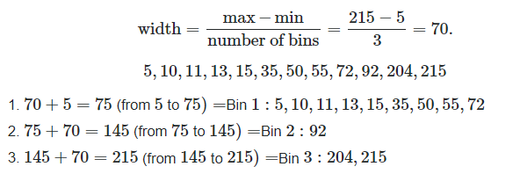
Equal width -Binning
Data set

Slide 48
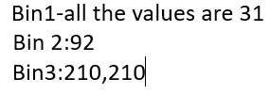
Smoothening
Binning by Mean
Bin1: 5,10,11,13,35,50,55,72 Mean=31
Bin2: 92
Bin3:204,215
Binning by Median Median =24
Bin1:all the values are 24
Bin2:92
Bin3:210
Binning by boundries
Bin1 :5,5,5,5,5,72,72,72
Bin2:92
Bin:204,215

Slide 49
Binning
Example: For the data set {4,8,15,21,21,24,25,28,34}
Partition into equal – frequency bins would be
Smoothing by bin mean
Bin1: 4,8,15
Bin2: 21,21,24
Bin3: 25,28,34
Smoothing by bins boundaries
Bin1: 9,9,9
Bin2: 22,22,22 Bin3: 29,29,29
Bin1: 4,4,15
Bin2: 21,21,24
Bin3: 25,25,34

Slide 50
Normalization
Transforming the data to fall within a smaller or common range such as [-1, 1] or [0.0, 1.0]
Various methods
Min-max normalization
Decimal scaling

Slide 51


Normalization
Suppose the minimum and maximum value for an attribute profit(P) are Rs. 10, 000 and Rs. 100, 000. We want to plot the profit in the range [0, 1].
Using min-max normalization the value of Rs. 20, 000 for attribute profit can be plotted to:
And hence, we get the value of v’ as 0.11

Slide 52
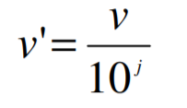
Normalization
Normalization by decimal scaling normalizes by moving the decimal point of values of attribute A
The number of decimal points moved depends on the maximum absolute value of A
A value, vi , of A is normalized to by computing where j is the smallest integer such that
Example:
Let the input data is: -10, 201, 301, -401, 501, 601, 701
To normalize the above data, Step 1: Maximum absolute value in given data(m): 701 Step 2: Divide the given data by 1000 (i.e j=3)
Result: The normalized data is: -0.01, 0.201, 0.301, -0.401, 0.501, 0.601, 0.701

Slide 53
Data Reduction

Slide 54
Data Reduction
Data reduction obtain a reduced representation of the data set that is much smaller in volume, but yet produces (almost)same analytical results
Why data reduction?
long time to run on the complete data set
reduce the storage space required
Speed
It removes redundant features.

Slide 55
Data Reduction technique
Data reduction strategies
Dimensionality reduction, e.g., remove unimportant attributes
Wavelet transforms
Principal Components Analysis (PCA)
Feature or attribute subset selection
Numerosity reduction (some simply call it: Data Reduction)
Regression and Log-Linear Models
Histograms, clustering, sampling
Data cube aggregation
Data compression

Slide 56
Data reduction -Wavelet Transforms
Discrete wavelet transform (DWT) is helps to compress a data. It is applicable linear signal processing, image compression
Compressed approximation: store only a small fraction of the strongest of the wavelet coefficients

Slide 57
Principal Components Analysis (PCA)
Find a projection that captures the largest amount of variation in data
The original data are projected onto a much smaller space, resulting in dimensionality reduction
x₂
e
x₁

Slide 58
Attribute Subset Selection
Another way to reduce dimensionality of data
Redundant attributes
Duplicate much or all of the information contained in one or more other attributes
E.g., purchase price of a product and the amount of sales tax paid
Irrelevant attributes
Contain no information that is useful for the data mining task at hand
E.g., students' ID is often irrelevant to the task of predicting students' GPA

Slide 59
Heuristic Search in Attribute Selection
For n attributes, there are 2^{n} possible subsets
Typical heuristic attribute selection methods:
Stepwise Forward Selection.
2. Stepwise Backward Elimination.
3. Combination of Forward Selection and Backward Elimination.
4.Decision tree

Slide 60
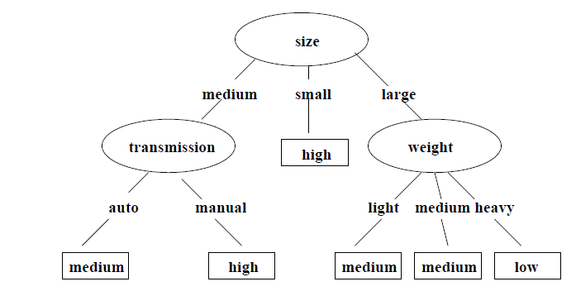
Heuristic Search in Attribute Selection
Example
Initial attribute set {size, transmission, weight, color}
Attributes required to determine the car mileage
Reduced attribute set {size,transmission,weight}

Slide 61
Attribute Creation (Feature Generation)
Create new attributes (features) that can capture the important information in a data set more effectively than the original ones
Three general methodologies
Attribute extraction
Domain-specific
Mapping data to new space (see: data reduction)
E.g., Fourier transformation, wavelet transformation
Attribute construction
Combining features
Data discretization
Notes:
61

Slide 62
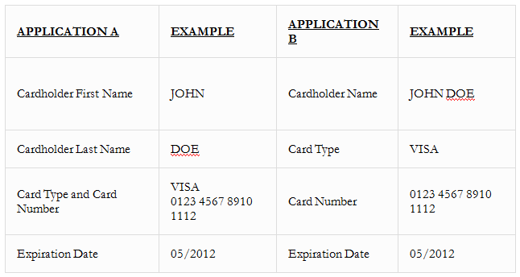
Eg-Attribute construction

Slide 63
Data Reduction: Numerosity Reduction
Reduce data volume by choosing alternative, smaller forms of data representation
Parametric methods (e.g., regression)
Assume the data fits some model, estimate model parameters, store only the parameters, and discard the data Ex.: Log-linear models—obtain value at a point in m-D space as the product on appropriate marginal subspaces
Non-parametric methods
Do not assume models
Major families: histograms, clustering,

Slide 64
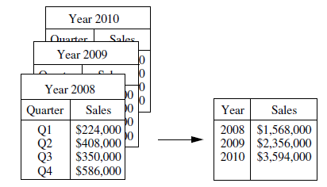
Data Aggregation
Collected data consist of the sales per quarter, for the years 2008 to 2010
Data of interest is in the annual sales (total per year)
Data can be aggregated such that the resulting data set is smaller in volume, without loss of information necessary for the analysis task

Slide 65
Thank You… ☺
Q&A
Suggestions / Feedback
In next session
Types of data set
Types of attribute
Basic Statistical Descriptions of Data
Data similarities and dissimilarities

Slide 66
Practice problems:
1.Check whether sale of ice-creams and sunglasses are related
2.Suppose 2 stocks A&B have following values in one week
(2,5),(3,8),(5,10),(4,11),(6,14) check if stocks are affected by same industry trends. Will their prices rise or fall together?
3. Researchers have conducted a survey of 1600 coffee drinkers asking how much coffee they drink in order to confirm previous studies. Previous studies have indicated that 72% of Americans drink coffee. The results of previous studies (left) and the survey (right) are below. At α = 0.05, is there enough evidence to conclude that the distributions are the same? 1
Ice cream sales | Sunglasses sales
20 | 30
10 | 5
23 | 29
5 | 10

